Slide 1




Yan Holtz | Brisbane | 2018
TEN TIPS FOR A BETTER DATA ANALYSIS PIPELINE IN RESEARCH

Slide 2


r4ds.had.co.nz

Slide 3
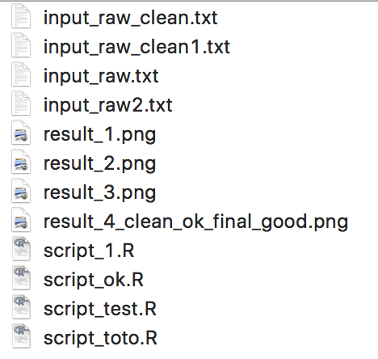
ORGANIZE

Slide 4
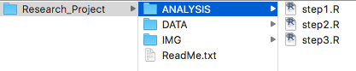
ORGANIZE
Don’t modify input files manually
Don’t copy and paste code / results
Use code to do everything

Slide 5






CODE
Notes:
What is R
What is the tidyverse
Why not Excel

Slide 6
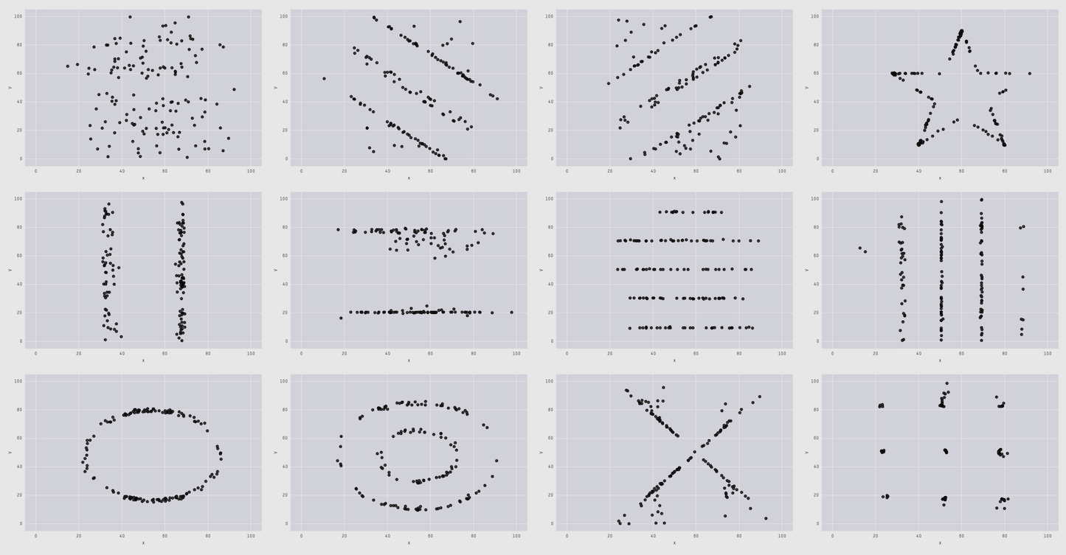
VISUALIZE
X Mean: 54.26
Y Mean: 47.83
X Sd: 15.76
Y Sd: 26.93
Correlation: -0.06
Notes:
Why: Dynausaurus
How: R graph gallery

Slide 7
VISUALIZE
X Mean: 54.26
Y Mean: 47.83
X Sd: 15.76
Y Sd: 26.93
Correlation: -0.06
Notes:
Why: Dynausaurus
How: R graph gallery

Slide 8
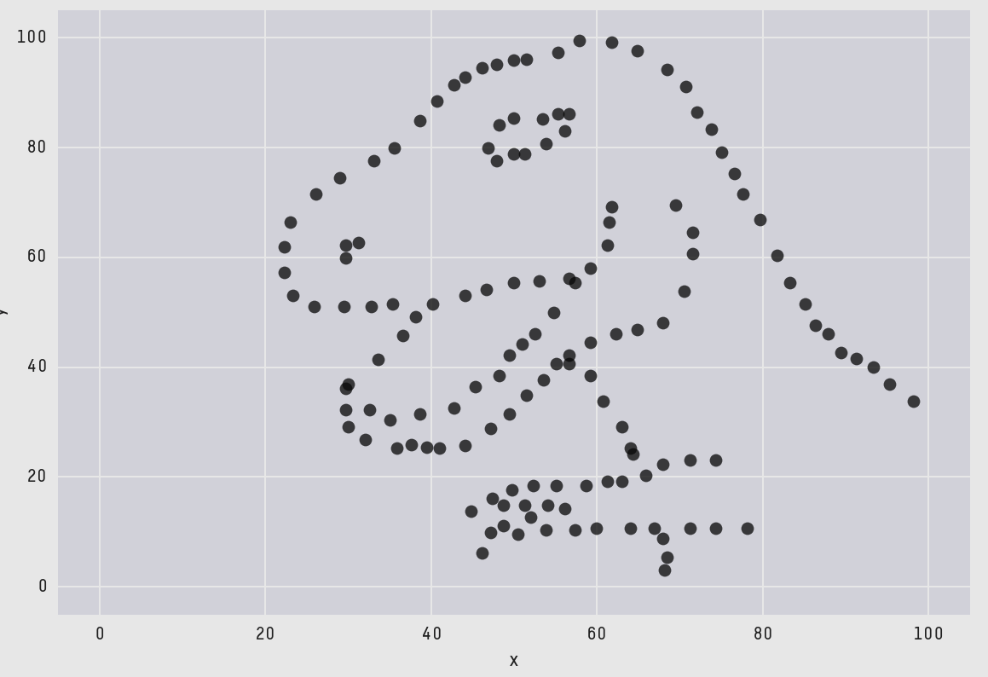
VISUALIZE
The Datasaurus Dozen
Cairo , 2017
Matejka & Fitzmaurice, 2017
Notes:
Why: Dynausaurus
How: R graph gallery

Slide 9
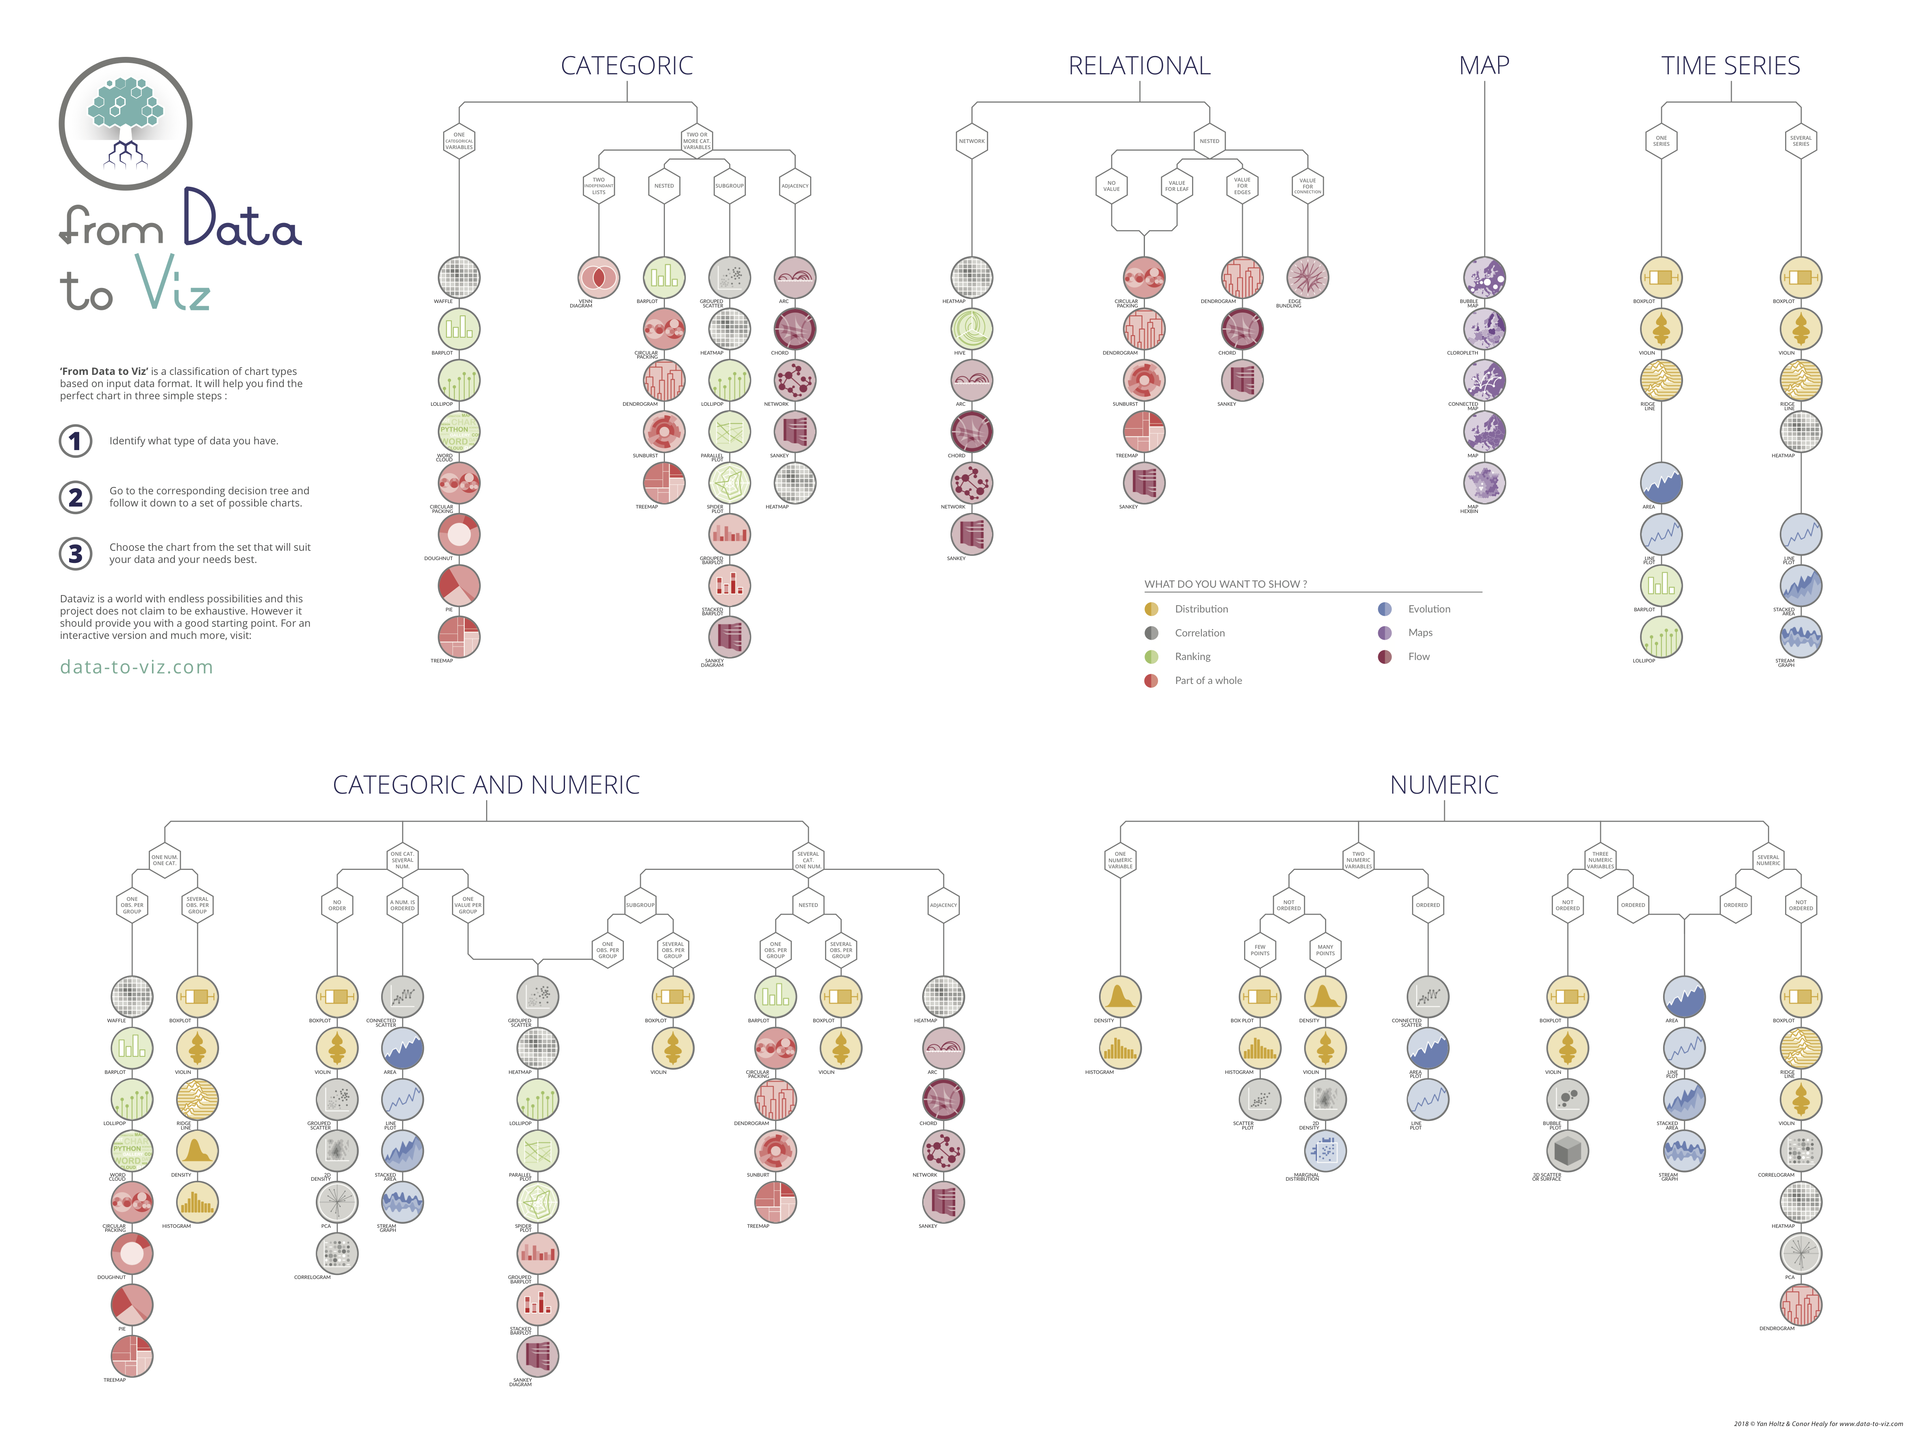
AVOID CAVEATS
data-to-viz.com
R-graph-gallery.com
Python-graph-gallery.com
Notes:
DEMO

Slide 10

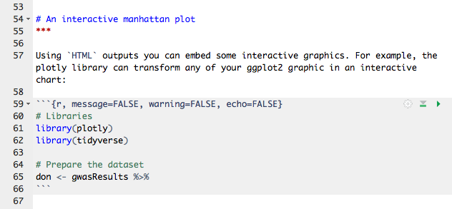
REPORT
Title
Text
Code
Is your code reusable ?
Notes:
Demo of what it is

Slide 11
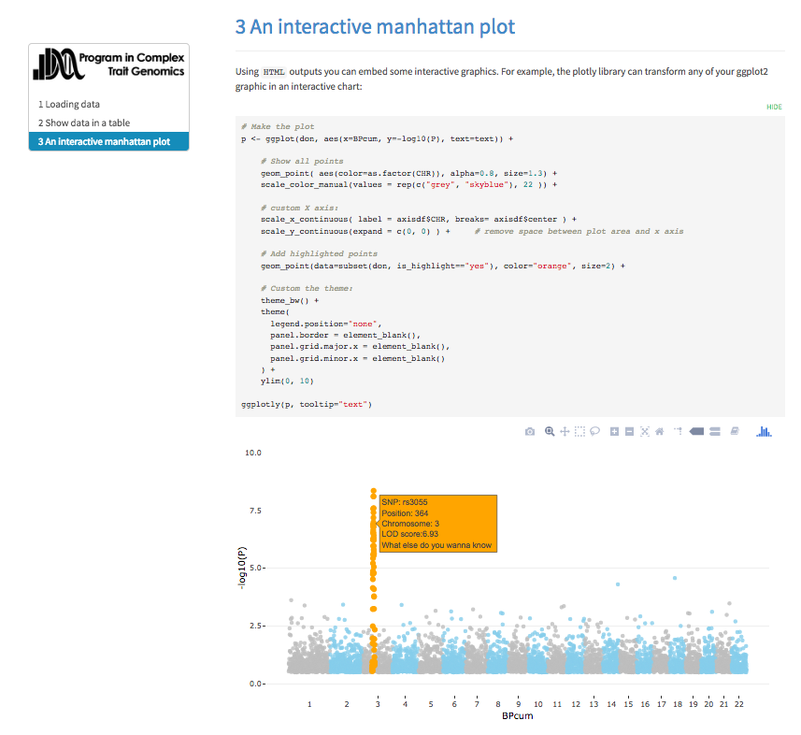
REPORT
Title
Text
Code
Interactive report
Is your code reusable ?
Notes:
3 examples of dataviz project concerning the UK Biobank and the Danish Register.

Slide 12
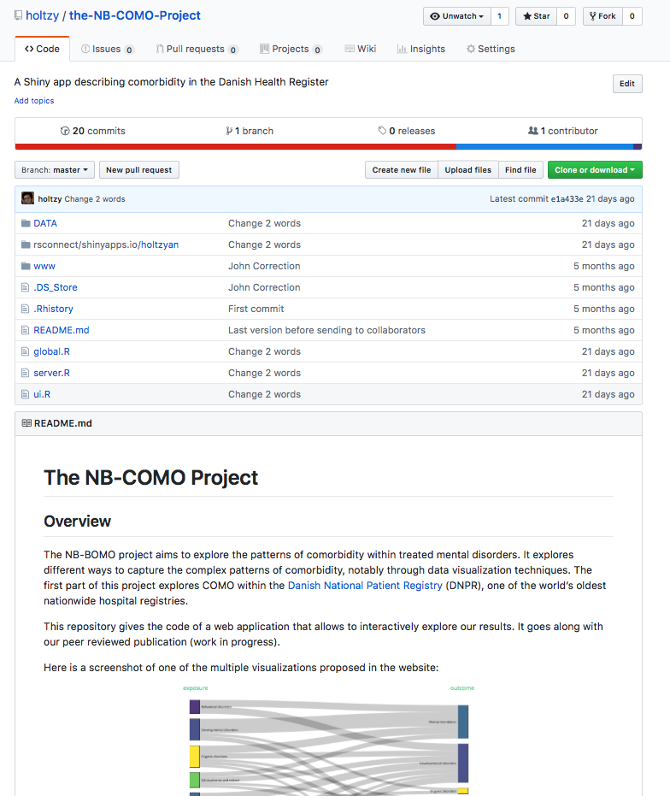
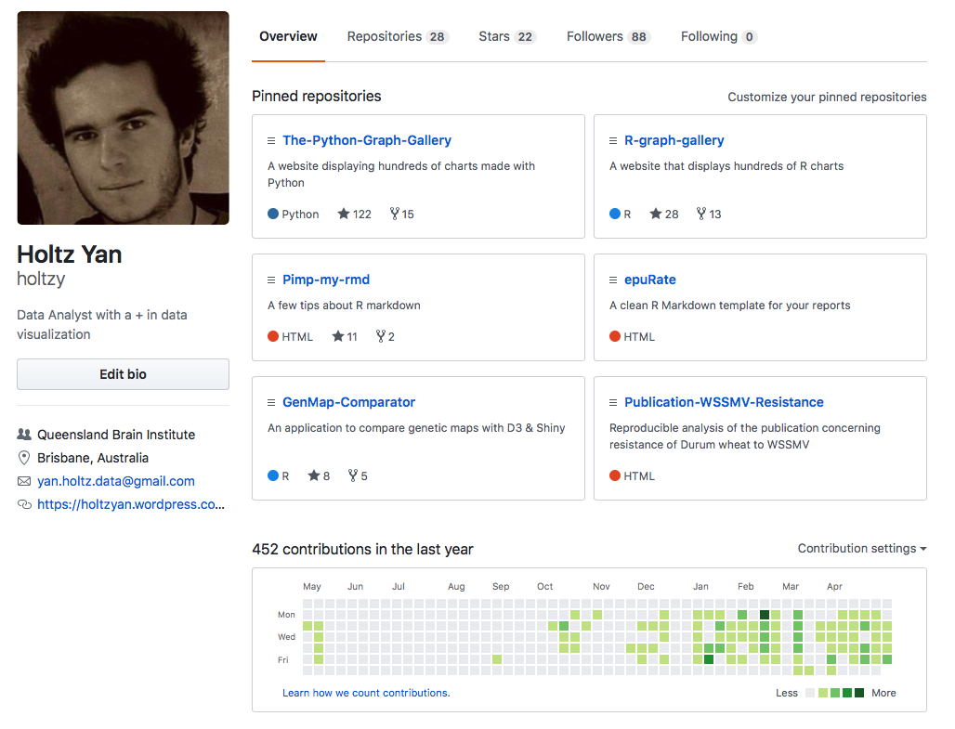
VERSION CONTROL
Notes:
DEMO

Slide 13

SHARE
Notes:
Do a demo

Slide 14





Acknowledgment
Contact
@R_Graph_Gallery
github.com/holtzy/Talk
Yan.holtz.data@gmail.com
R-graph-gallery.com
John McGrath
Naomi Wray
Peter Vissher
Jian Yang

